Slide 1
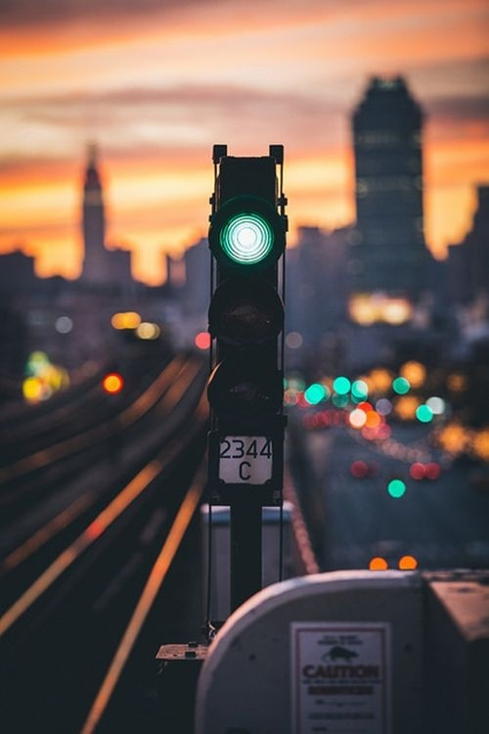
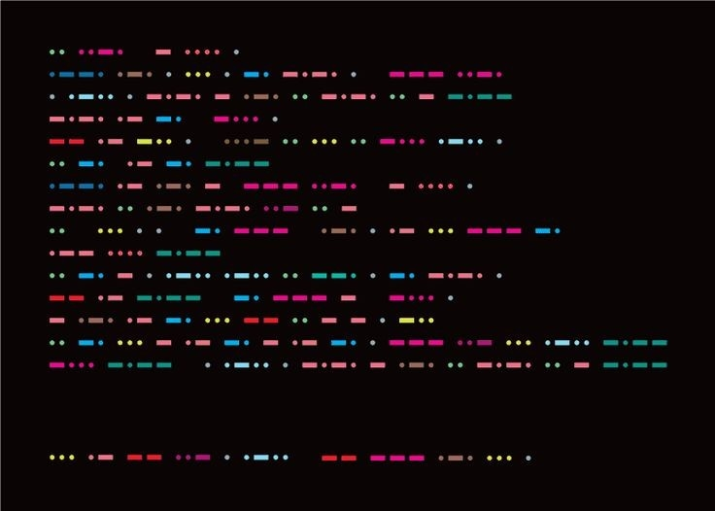
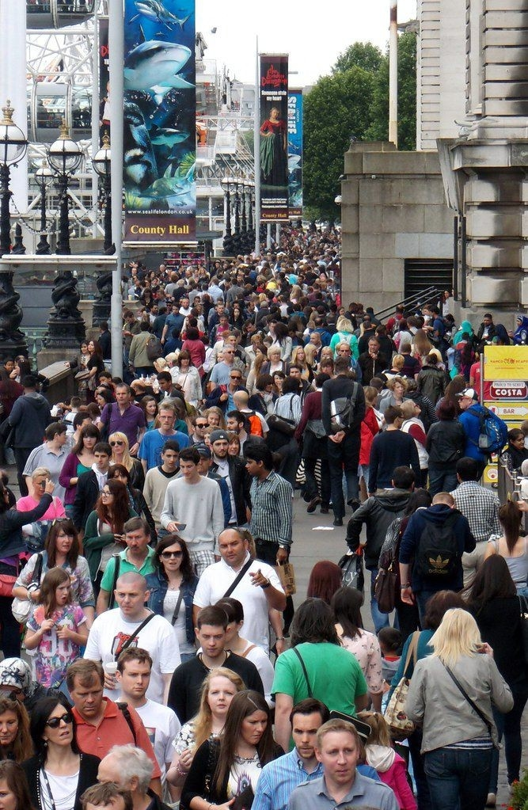

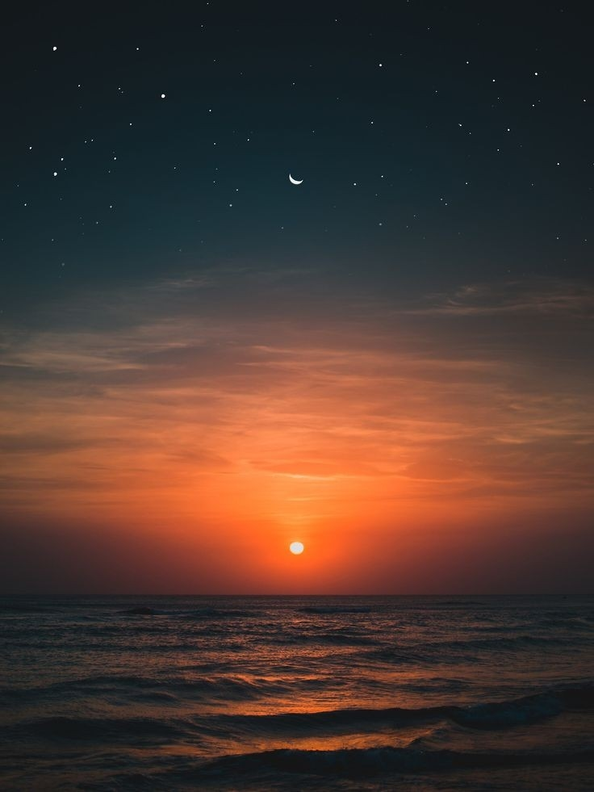
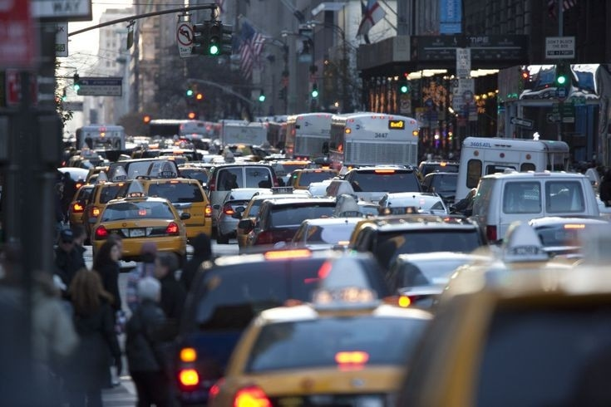
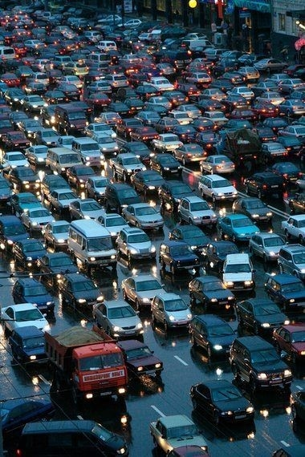
TRAFFIC LIGHT CONTROL SYSTEM

Slide 2

Design a fuzzy traffic light control system that determines the duration of a green signal at an intersection based on 3 inputs.
TRAFFIC LIGHT CONTROL SYSTEM
Traffic Volume
Time Of Day
Pedestrain presence

Slide 3
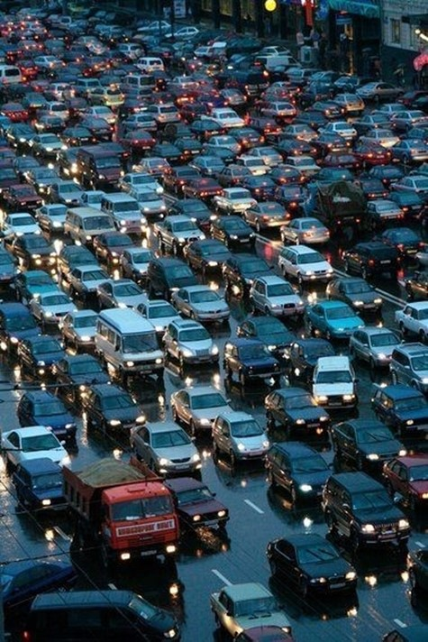
TRAFFIC VOLUME
Membership functions:
TRAFFIC LIGHT CONTROL SYSTEM
Low
Moderate
High
Very High
Range:
From 0 to 1000 vehicles per hour.

Slide 4
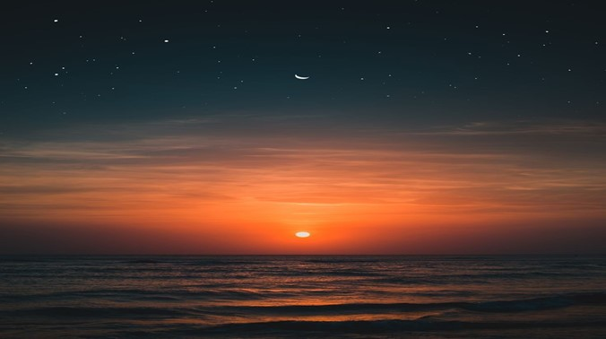
TIME OF DAY
Membership functions:
TRAFFIC LIGHT CONTROL SYSTEM
Night
Morning
Afternoon
Evening
Range:
From 0 to 24 hours.

Slide 5
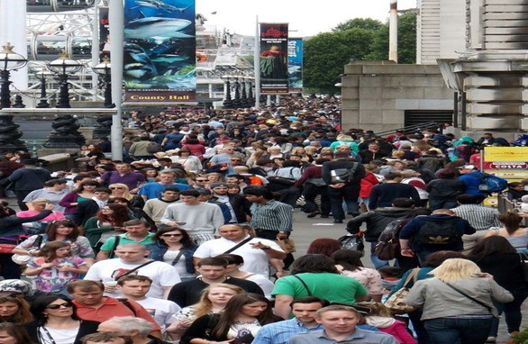
PEDESTRAIN PRESENCE
Membership functions:
TRAFFIC LIGHT CONTROL SYSTEM
None
Few
Moderate
Money
Range:
From 0 to 100 pedestrains.

Slide 6

GREEN SIGNAL DURATION
Membership functions:
TRAFFIC LIGHT CONTROL SYSTEM
Short
Moderate
Long
Very Long
Range:
From 0 to 120 seconds.

Slide 7

If the traffic volume is LOW ,time of day is NIGHT and the pedestrian presence is NONE → the green signal duration will be LONG.
If the traffic volume is MODERATE ,time of day is NIGHT and the pedestrian presence is NONE → the green signal duration will be LONG.
If the traffic volume is V.HIGH ,time of day is NIGHT and the pedestrian presence is NONE → the green signal duration will be V.LONG.
TRAFFIC LIGHT CONTROL SYSTEM

Slide 8
If the traffic volume is LOW ,time of day is EVENING and the pedestrian presence is MANY → the green signal duration will be LONG.
If the traffic volume is V.HIGH ,time of day is MORNING and the pedestrian presence is FEW → the green signal duration will be SHORT.
If the traffic volume is MODERATE ,time of day is MORNING and the pedestrian presence is FEW → the green signal duration will be SHORT.
TRAFFIC LIGHT CONTROL SYSTEM

Slide 9
RENAD OMAR
OLA MAHMOUD
AYA ADEEB
TRAFFIC LIGHT CONTROL SYSTEM

Slide 10
TRAFFIC LIGHT CONTROL SYSTEM

Slide 11
